Slide 1
Machine Learning for data science and business intelligence – 8IAR403
By Kévin Bouchard Ph.D.
Professor in artificial intelligence & machine learning
Laboratoire d'Intelligence Ambiante pour la reconnaissance d'activités (LIARA)
Université du Québec à Chicoutimi
www.Kevin-Bouchard.ca

Slide 2

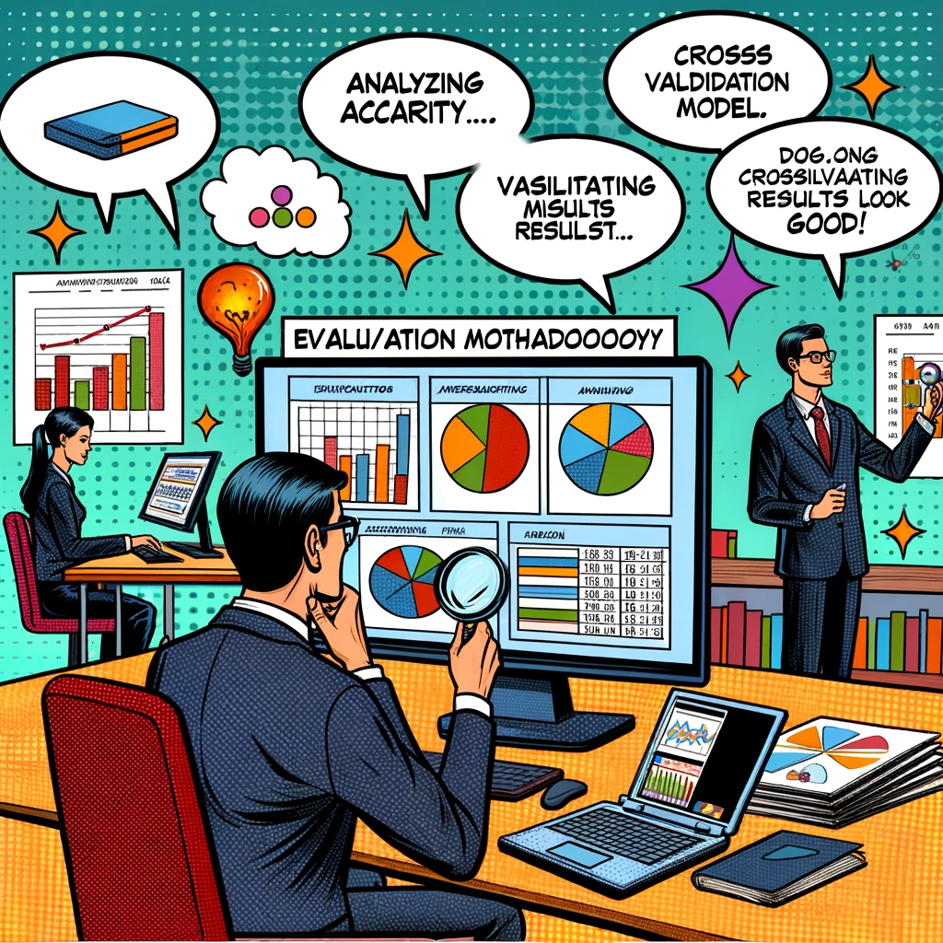

Summary of lesson #9
You will learn about:
Main evaluation metrics for classification
Strengths and weaknesses for each of them
How to extend them to multiple classes
How to perform the tests on your data

Slide 3
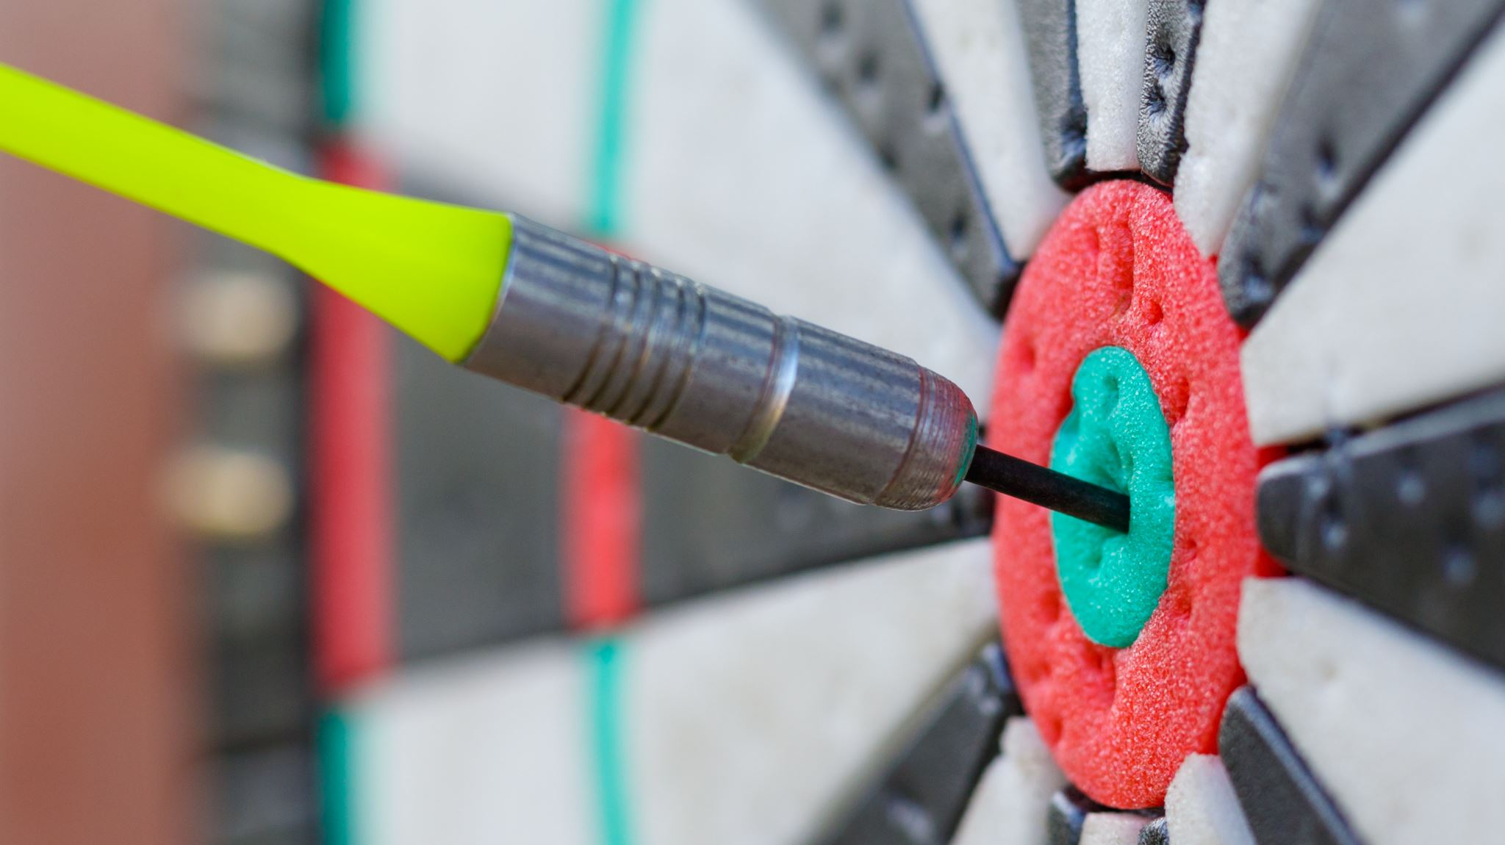
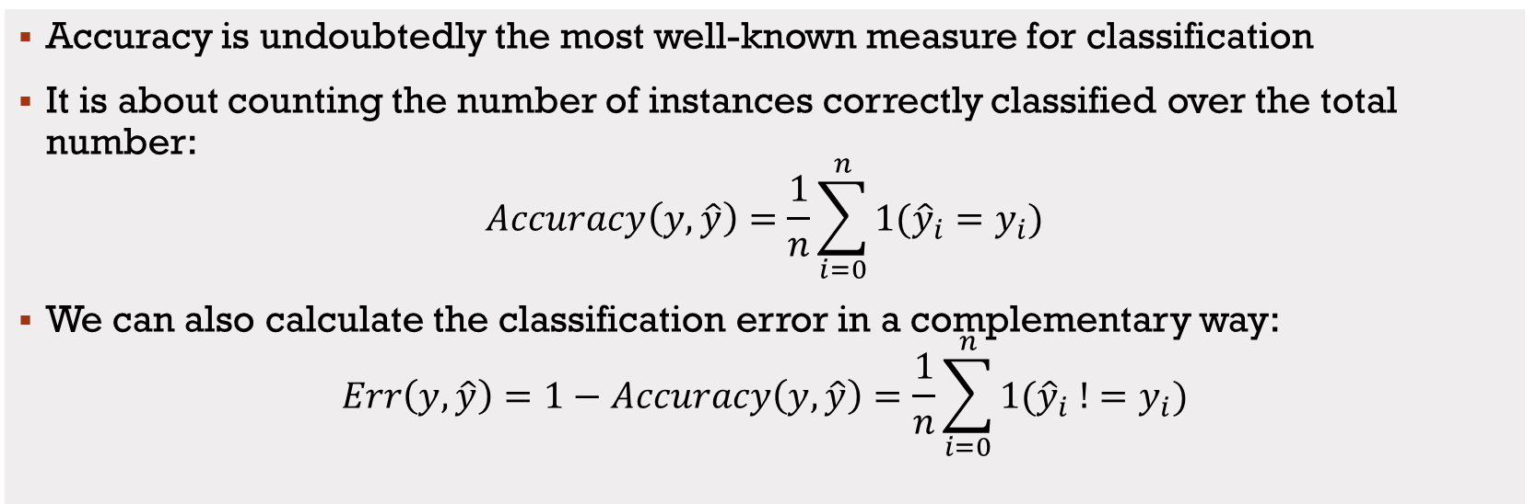

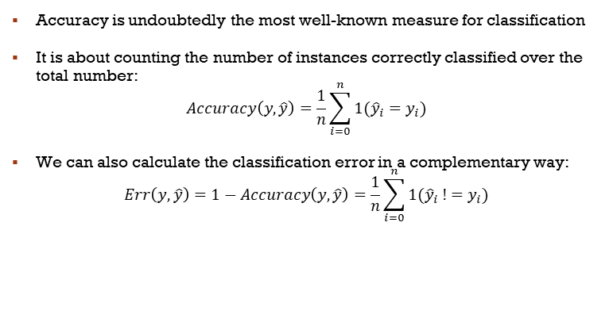
Accuracy
Accuracy
Accuracy is undoubtedly the most well-known measure for classification
It is about counting the number of instances correctly classified over the total number:
$$Accuracy\left(y, \hat{y}\right)=\frac{1}{n}\sum_{i=0}^{n}{1({\hat{y}}_{i}=y_{i})}$$
We can also calculate the classification error in a complementary way:
$$Err\left(y, \hat{y}\right)=1−Accuracy\left(y, \hat{y}\right)=\frac{1}{n}\sum_{i=0}^{n}{1({\hat{y}}_{i} !=y_{i})}$$
Accuracy is undoubtedly the most well-known measure for classification
It is about counting the number of instances correctly classified over the total number:
$$Accuracy\left(y, \hat{y}\right)=\frac{1}{n}\sum_{i=0}^{n}{1({\hat{y}}_{i}=y_{i})}$$
We can also calculate the classification error in a complementary way:
$$Err\left(y, \hat{y}\right)=1−Accuracy\left(y, \hat{y}\right)=\frac{1}{n}\sum_{i=0}^{n}{1({\hat{y}}_{i} !=y_{i})}$$

Slide 4
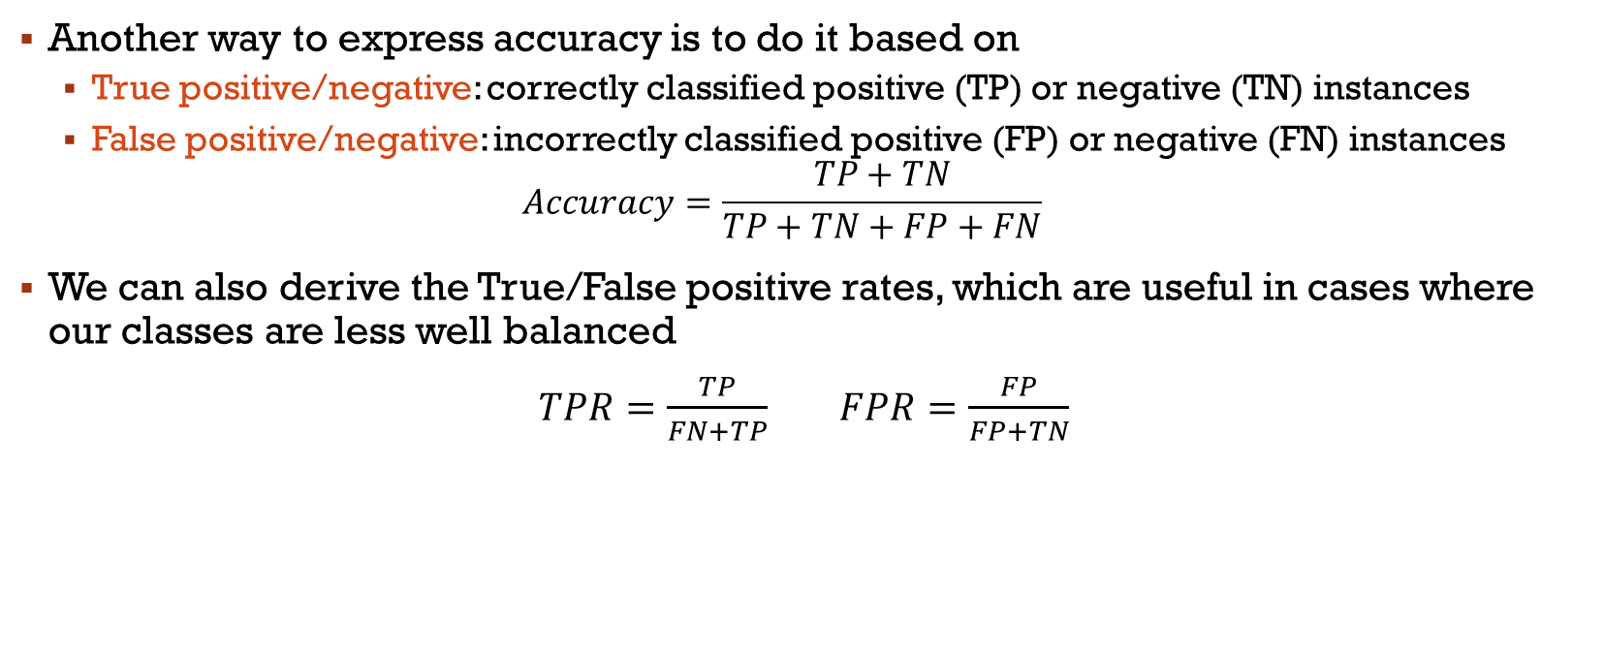
True/False positives
Another way to express accuracy is to do it based on
True positive/negative: correctly classified positive (TP) or negative (TN) instances
False positive/negative: incorrectly classified positive (FP) or negative (FN) instances
$$Accuracy=\frac{TP+TN}{TP+TN+FP+FN}$$
We can also derive the True/False positive rates, which are useful in cases where our classes are less well balanced
$TPR=\frac{TP}{FN+TP}$ $FPR=\frac{FP}{FP+TN}$

Slide 5
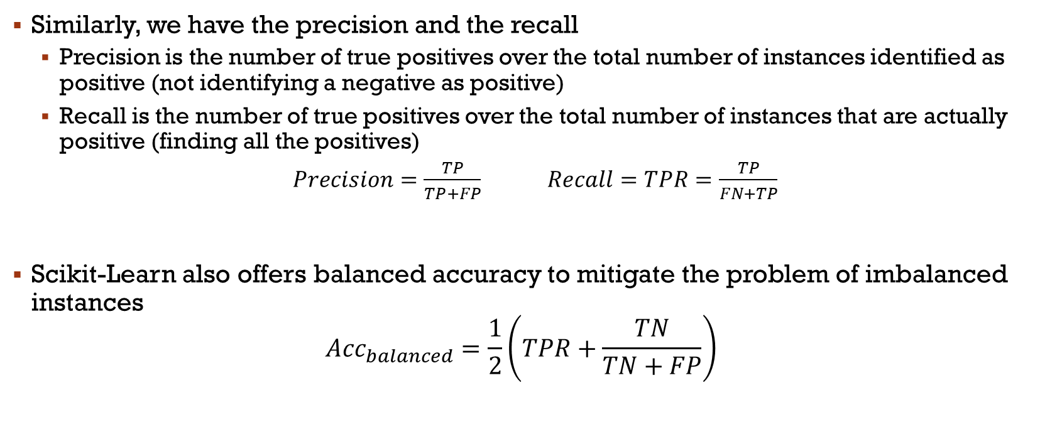
Precision and Recall
Similarly, we have the precision and the recall
Precision is the number of true positives over the total number of instances identified as positive (not identifying a negative as positive)
Recall is the number of true positives over the total number of instances that are actually positive (finding all the positives)
$Precision=\frac{TP}{TP+FP}$ $Recall=TPR=\frac{TP}{FN+TP}$
Scikit-Learn also offers balanced accuracy to mitigate the problem of imbalanced instances
$${Acc}_{balanced}=\frac{1}{2}\left(TPR+\frac{TN}{TN+FP}\right)$$

Slide 6
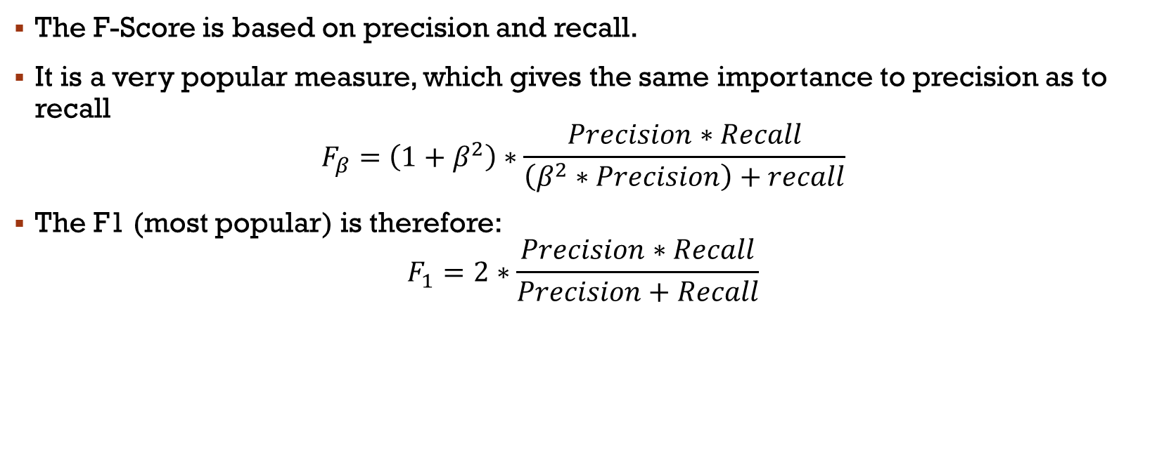
F-Score
The F-Score is based on precision and recall.
It is a very popular measure, which gives the same importance to precision as to recall
$$F_{β}=\left(1+β^{2}\right)∗\frac{Precision∗Recall}{\left(β^{2}∗Precision\right)+recall}$$
The F1 (most popular) is therefore:
$$F_{1}=2∗\frac{Precision∗Recall}{Precision+Recall}$$

Slide 7
Example
Let’s consider we test 100 people for a disease
20 have the disease (positive class)
80 do not (negative class)
Of those who actually have the disease:
15 were correctly identified as having the disease (True Positives, TP)
5 were incorrectly identified as not having the disease (False Negatives, FN)
Of those who do not have the disease:
70 were correctly identified as not having the disease (True Negatives, TN)
10 were incorrectly identified as having the disease (False Positives, FP)

Slide 8
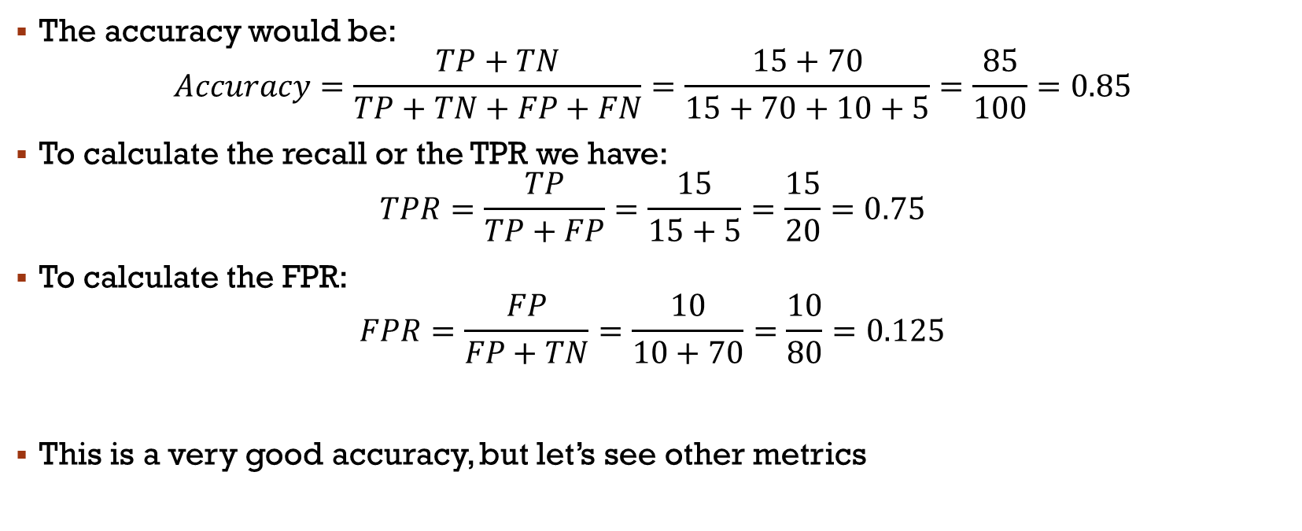
Example
The accuracy would be: $Accuracy=\frac{TP+TN}{TP+TN+FP+FN}=\frac{15+70}{15+70+10+5}=\frac{85}{100}=0.85$
To calculate the recall or the TPR we have:
$$TPR=\frac{TP}{TP+FP}=\frac{15}{15+5}=\frac{15}{20}=0.75$$
To calculate the FPR:
$$FPR=\frac{FP}{FP+TN}=\frac{10}{10+70}=\frac{10}{80}=0.125$$
This is a very good accuracy, but let’s see other metrics

Slide 9
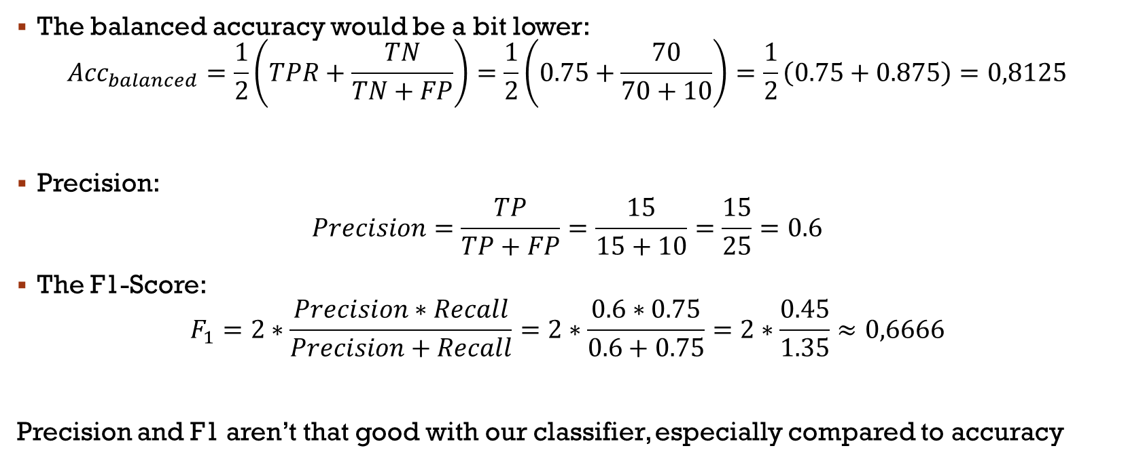
Example
The balanced accuracy would be a bit lower:
$${Acc}_{balanced}=\frac{1}{2}\left(TPR+\frac{TN}{TN+FP}\right)=\frac{1}{2}\left(0.75+\frac{70}{70+10}\right)=\frac{1}{2}\left(0.75+0.875\right)=0,8125$$
Precision:
$$Precision=\frac{TP}{TP+FP}=\frac{15}{15+10}=\frac{15}{25}=0.6$$
The F1-Score:
$$F_{1}=2∗\frac{Precision∗Recall}{Precision+Recall}=2∗\frac{0.6∗0.75}{0.6+0.75}=2∗\frac{0.45}{1.35}≈0,6666$$
Precision and F1 aren’t that good with our classifier, especially compared to accuracy

Slide 10
Kappa
The Kappa-score is another very popular measure
It's used to quantify the level of agreement between two raters
In classification tasks, it measures how much better a classifier is performing over the baseline of random chance
While the F-Score focuses on the balance between precision and recall, the Kappa-score provides a more holistic view of the classifier's performance across all categories
Notes:
Pas dispo dans TF

Slide 11
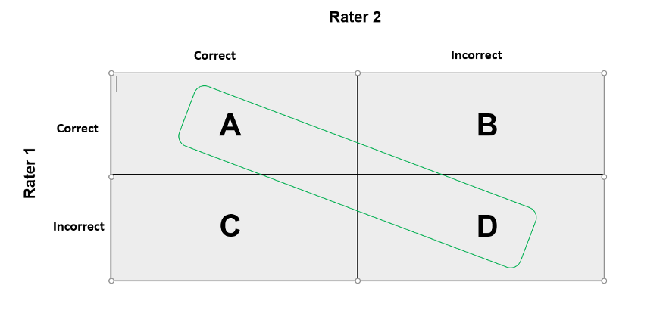
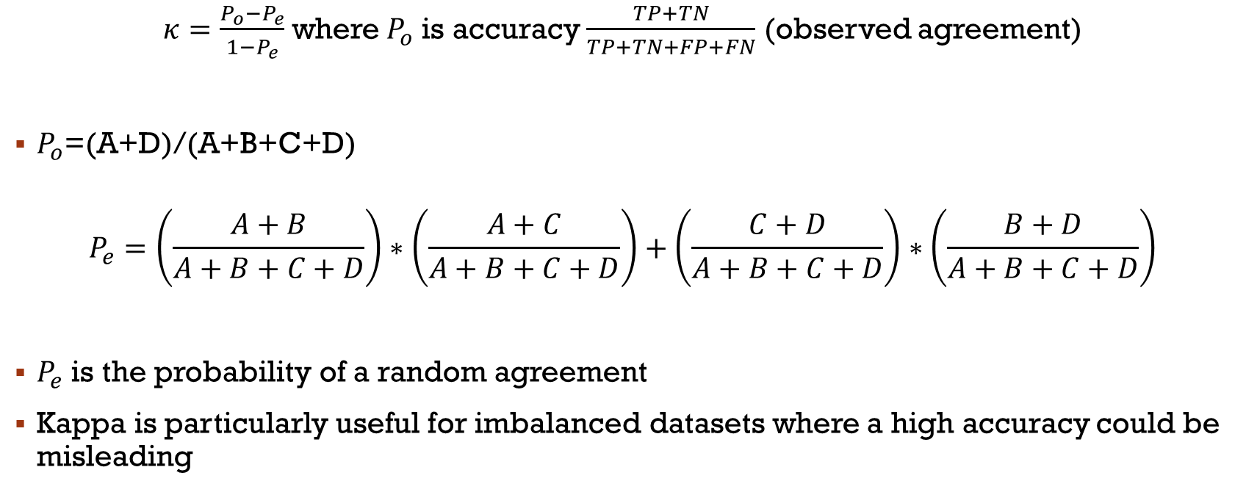
Kappa
$κ=\frac{P_{o}−P_{e}}{1−P_{e}}$ where$P_{o}$ is accuracy $\frac{TP+TN}{TP+TN+FP+FN}$ (observed agreement)
$P_{o}$=(A+D)/(A+B+C+D)
$$P_{e}=\left(\frac{A+B}{A+B+C+D}\right)∗\left(\frac{A+C}{A+B+C+D}\right)+\left(\frac{C+D}{A+B+C+D}\right)∗\left(\frac{B+D}{A+B+C+D}\right)$$
$P_{e}$ is the probability of a random agreement
Kappa is particularly useful for imbalanced datasets where a high accuracy could be misleading

Slide 12
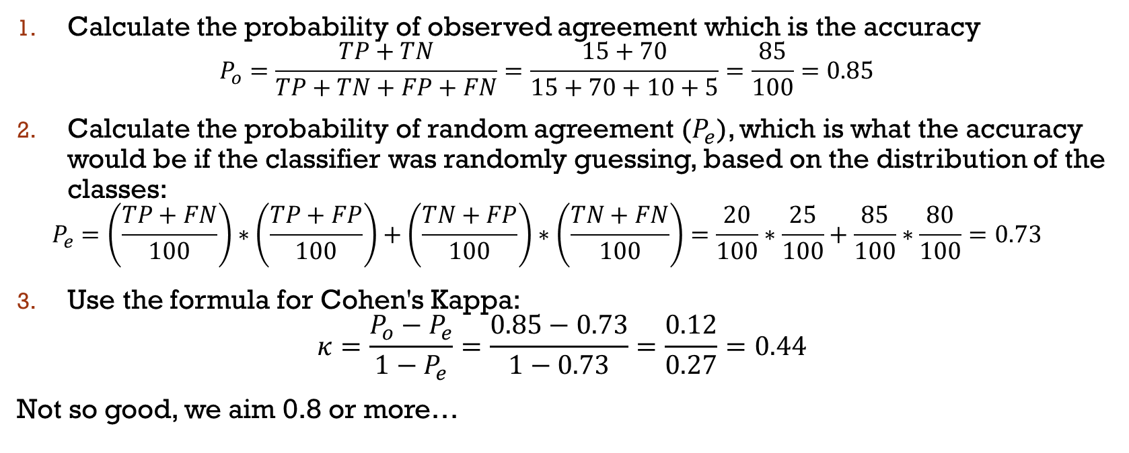
Using our previous example
Calculate the probability of observed agreement which is the accuracy
$$P_{o}=\frac{TP+TN}{TP+TN+FP+FN}=\frac{15+70}{15+70+10+5}=\frac{85}{100}=0.85$$
Calculate the probability of random agreement ($P_{e}$), which is what the accuracy would be if the classifier was randomly guessing, based on the distribution of the classes:
$$P_{e}=\left(\frac{TP+FN}{100}\right)∗\left(\frac{TP+FP}{100}\right)+\left(\frac{TN+FP}{100}\right)∗\left(\frac{TN+FN}{100}\right)=\frac{20}{100}∗\frac{25}{100}+\frac{85}{100}∗\frac{80}{100}=0.73$$
Use the formula for Cohen's Kappa:
$$κ=\frac{P_{o}−P_{e}}{1−P_{e}}=\frac{0.85−0.73}{1−0.73}=\frac{0.12}{0.27}=0.44$$
Not so good, we aim 0.8 or more…

Slide 13


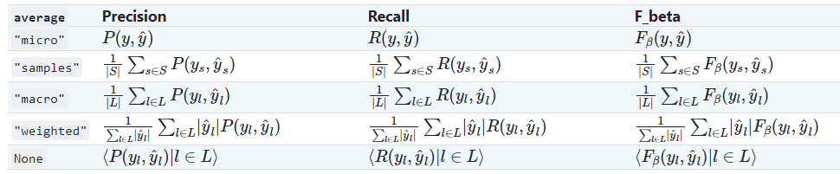
Multiple classes?
Okay, we have defined our measures in terms of positives and negatives
In reality, most of the time, we have multiple classes
The simplest way to calculate the measures is to go One-vs-All
However, Scikit-Learn offers us these options:

Slide 14
Multiple classes?
binary: Only report results for the class specified by pos_label. This is applicable only if targets (y_{true,pred}) are binary.
micro: Calculate metrics globally by counting the total true positives, false negatives and false positives.
macro: Calculate metrics for each label, and find their unweighted mean. This does not take label imbalance into account.
weighted: Calculate metrics for each label, and find their average weighted by support (the number of true instances for each label). This alters ‘macro’ to account for label imbalance; it can result in an F-score that is not between precision and recall.
samples: Calculate metrics for each instance, and find their average (only meaningful for multilabel classification where this differs from accuracy_score).

Slide 15
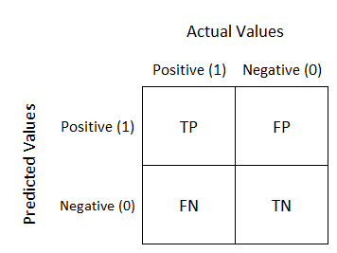
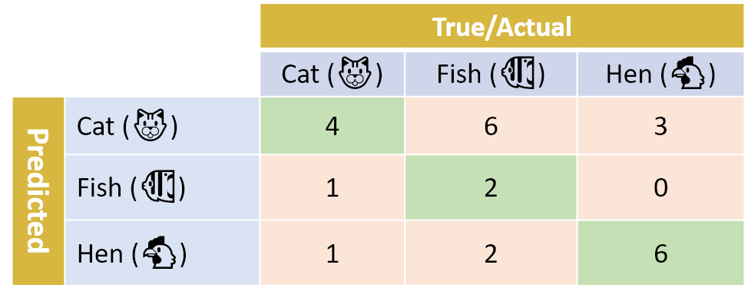
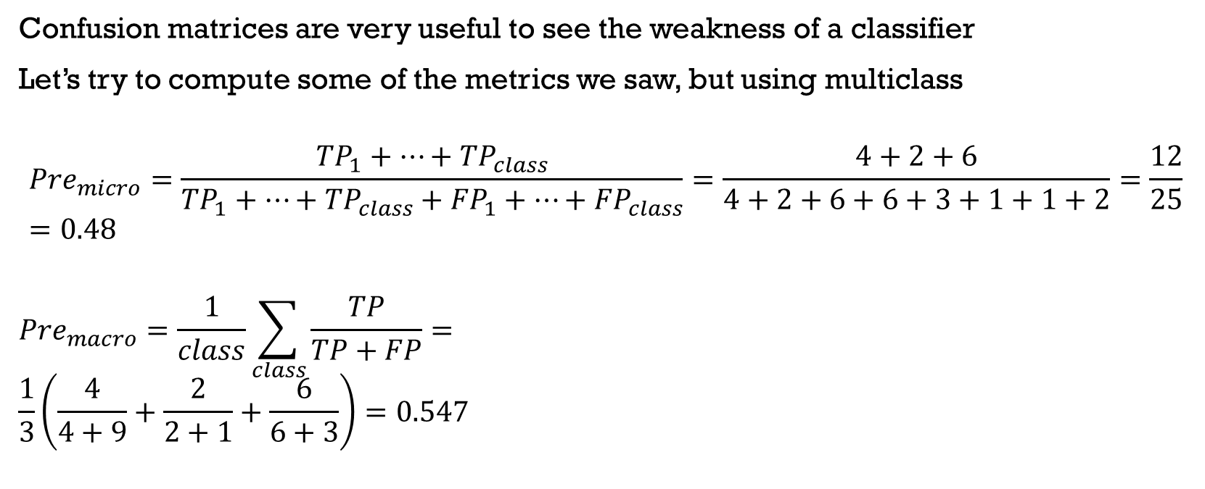
Confusion Matrices
Confusion matrices are very useful to see the weakness of a classifier
Let’s try to compute some of the metrics we saw, but using multiclass
$${Pre}_{micro}=\frac{{TP}_{1}+…+{TP}_{class}}{{TP}_{1}+…+{TP}_{class}+{FP}_{1}+…+{FP}_{class}}=\frac{4+2+6}{4+2+6+6+3+1+1+2}=\frac{12}{25}=0.48$$
$${Pre}_{macro}=\frac{1}{class}\sum_{class}{\frac{TP}{TP+FP}}= \\ \frac{1}{3}\left(\frac{4}{4+9}+\frac{2}{2+1}+\frac{6}{6+3}\right)=0.547$$
Notes:
Expliquer un peu

Slide 16
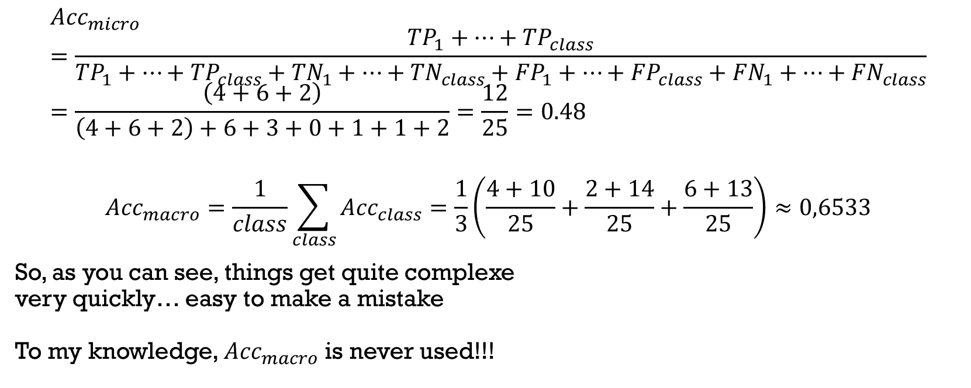
Matrices de Confusion
$${Acc}_{micro}=\frac{{TP}_{1}+…+{TP}_{class}}{{TP}_{1}+…+{TP}_{class}+{TN}_{1}+…+{TN}_{class}+{FP}_{1}+…+{FP}_{class}+{FN}_{1}+…+{FN}_{class}}=\frac{\left(4+6+2\right)}{\left(4+6+2\right)+6+3+0+1+1+2}=\frac{12}{25}=0.48$$
$${Acc}_{macro}=\frac{1}{class}\sum_{class}{{Acc}_{class}}=\frac{1}{3}\left(\frac{4+10}{25}+\frac{2+14}{25}+\frac{6+13}{25}\right)≈0,6533$$
So, as you can see, things get quite complexe very quickly… easy to make a mistake To my knowledge, ${Acc}_{macro}$ is never used!!!

Slide 17
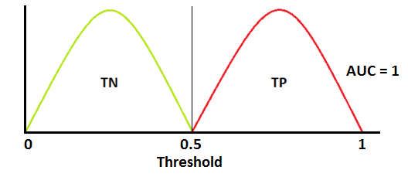
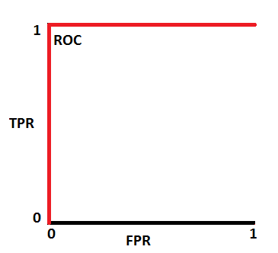
Receiver Operator Curve (ROC)
Based on the True Positive Rate (Y) and the False Positive Rate (X),
We measure the classification performance with different threshold values
Ideally, TPR=1 and FPR=0
We often focus instead on the Area Under the Curve (AUC) between 0 and 1
Notes:
Test avec cut-off (sigmoid, par défaut à 0.5… mais what happens if 0.4, 0.3…)

Slide 18
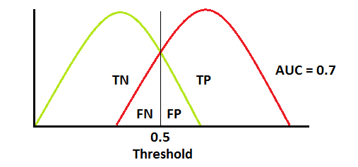
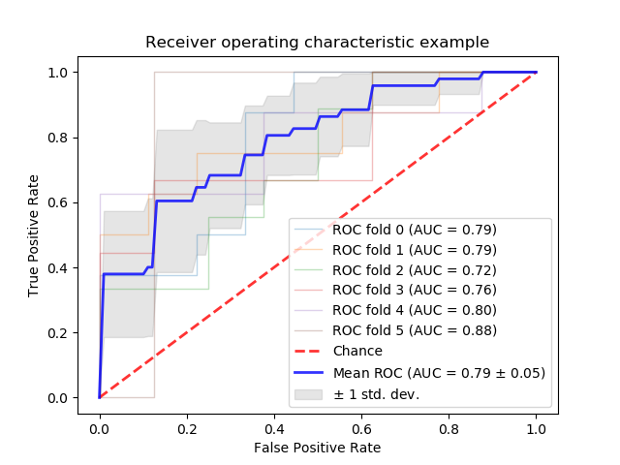
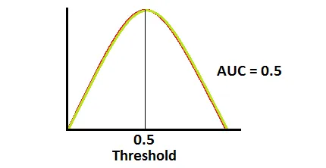
Receiver Operator Curve (ROC)
Let’s look at this code: https://scikit-learn.org/stable/auto_examples/model_selection/plot_roc.html
Or this: https://www.tensorflow.org/api_docs/python/tf/keras/metrics/AUC
Notes:
Basically we test with cut-off (sigmoid, par défaut à 0.5… but what happens if 0.4, 0.3…)

Slide 19
Test methodology
To see more about the metrics: https://scikit-learn.org/stable/modules/model_evaluation.html#classification-metrics

Slide 20
Splitting the dataset
The error on the training data is not a good indicator of performance on future data
Otherwise, 1-NN would be the absolute optimal classifier!
Therefore, we normally divide our dataset into training and test sets.
Split into train/test
Split into train/validation/test
Notes:
Revenir sur Val vs normal (valeur sur le dataset de test)

Slide 21
Why three sets?
It is important that the test data is not used in any way to create the classifier.
Some learning programs work in two steps:
Step 1: Build the basic structure
Step 2: Optimize the settings of the hyperparameters
Test data cannot be used for hyperparameters tuning!
We add a third set (validation) used to optimize the hyperparameters
We only use the test set at the very end!

Slide 22
Maximizing our labeled data
Annotated data are difficult to obtain and are very valuable
Therefore, their use must be maximized
Even in the era of Big Data!
Once the evaluation is completed, all data should be used to build the final classifier
In general, the more training data there is, the better the classifier
The more test data there is, the more precise the error estimation
Note here that error is always an estimation!

Slide 23
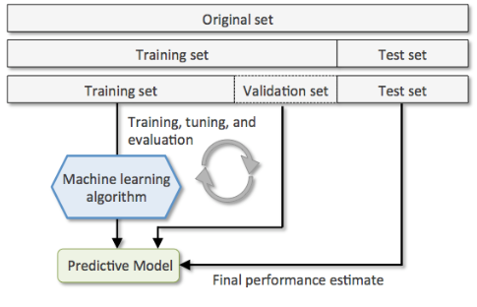
Holdout cross-validation
This is the basic method when optimizing among many models
https://scikit-learn.org/stable/modules/cross_validation.html

Slide 24
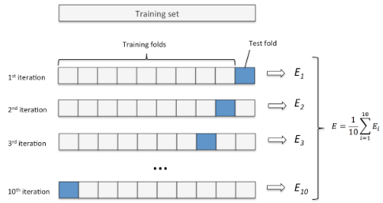
K-Fold cross-validation
Similar to the holdout, but k times (without replacement)
We usually average the performance on the k tests
Can be used to optimize the model
Notes:
C’est le validation en vrai si nous avons trois datasets

Slide 25
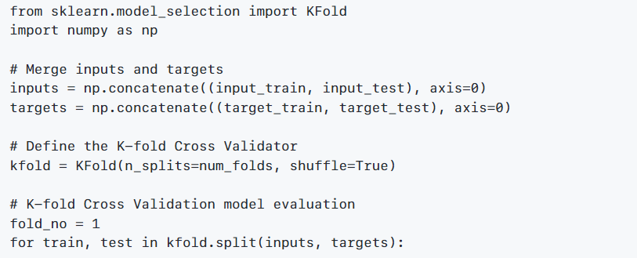
K-Fold Cross-validation
StratifiedKFold preserves the proportion of classes in the folds
GroupKFold, K must equal the number of groups, each group appears only once
StratifiedGroupKFold is a mix of the two
RepeatedKFold repeats a K-Fold with different RandomState (very long!)

Slide 26
Leave-One-Out (LOO)
By definition, in ML, LOO is simply a K-Fold where k equals the number of instances
However, in applied ML, LOO, often called leave-one-subject-out (LOSO), is slightly different
It aims to ensure that our model does not directly depend on human participants.
In this case, LOO consists of removing the instances of one participant, training the model on the others, and testing on the one that was removed
We can use the same technique for heterogeneous contexts
E.g.: we remove the data from one smart home out of n smart home
The GroupKFold of Scikit can be used to do exactly that! (i.e. a group being data from one person, independent of the class)
Notes:
En discuter
Exemple des habitats/humains/activités…
Un peu l’utilité du GroupKFold

Slide 27
Main References
Russell S., Norvig P., Artificial Intelligence: A Modern Approach. Prentice-Hall, Englewood Cliffs, 2021.
Aggarwal, C. C., Neural networks and deep learning. Springer, 2023.
Goodfellow I., Bengio Y., Deep Learning. The MIT Press, 2016.
Raschka S., Python Machine Learning, Packt Publishing, 2015.
Sutton R.S., Barto A.G., Reinforcement Learning: An Introduction, A Bradford Book, 2021.
Witten I.H., Frank E., Hall M.A., Pal C. Data Mining: Practical Machine Learning Tools and Techniques, Morgan Kaufmann, 2016.

